Slide 1
Cinema snack delivery app design
This is my take on a snack app designed for cinema use. I made two personas (one being disabled and requiring a wheelchair) but because I designed for my disabled user first and foremost, this design concept solved problems for other users.
The initial project chosen was to design an app for cinema snacks but creating for users with various challenges allowed me to problem solve to a greater degree and design a multi use app.
I worked to WCAG principles to make it inclusive but assistive technologies could be explored further - voice ordering, refined design for neuro-diverse etc.

Slide 2
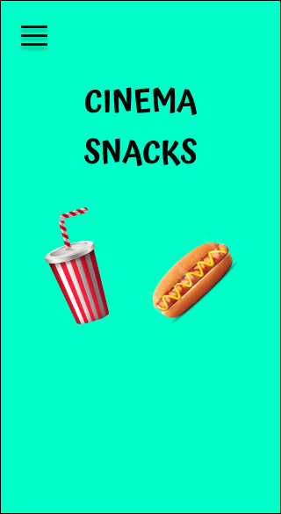
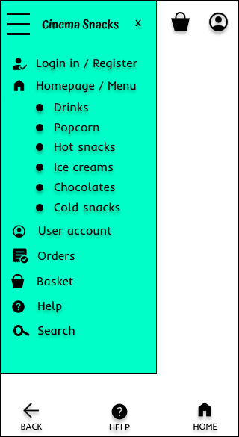
This is a basic splash screen for finished prototype.
This is my nav bar example.

Slide 3
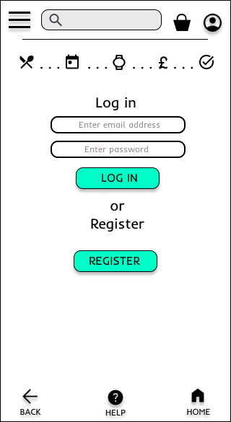
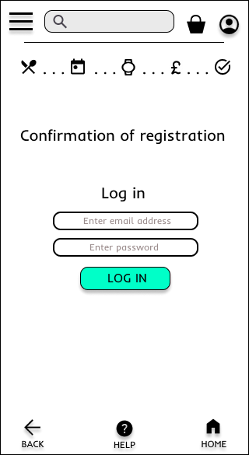
Login page
Confirmation of registration would show when successfully added to database

Slide 4
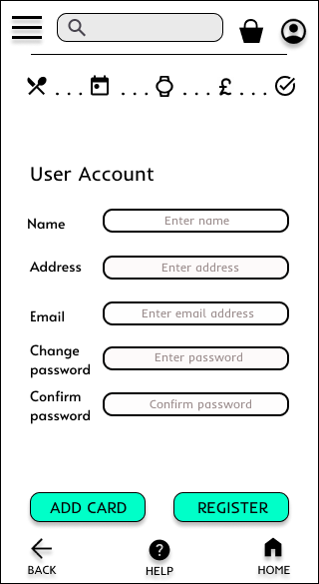
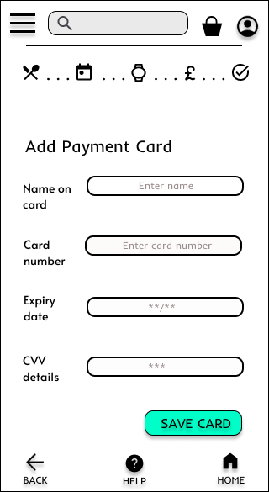
User account input which can lead on to the payment card section if selected.
Add a payment card for regular faster checkout.

Slide 5
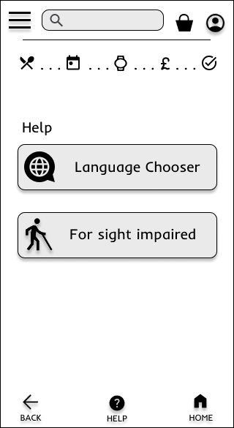
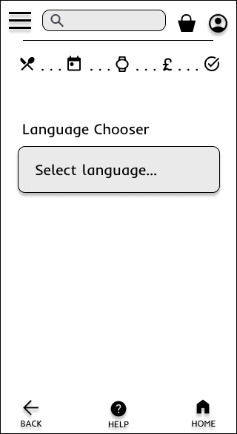
Assistive help page with two buttons - language chooser option and sight impaired.
If on a live app, a chooser element would appear.

Slide 6
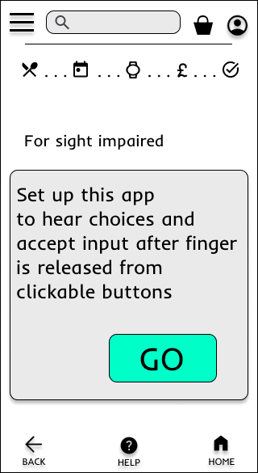
Assistive tech for android app use - Henshaws
This would be the initial page before the assistive technology snack menu. It is based on technology developed by Henshaws. I have linked their YouTube video.

Slide 7
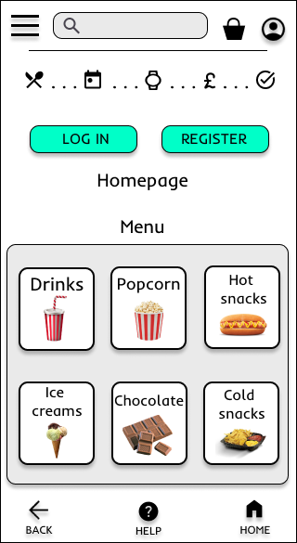
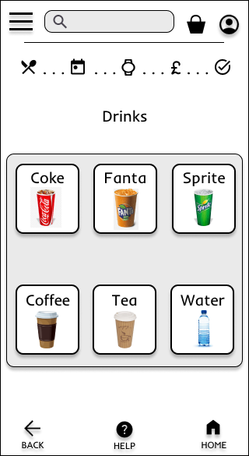
My menu page example. By clicking on the drinks page, it takes you to the drinks selection.
By clicking on Coke it takes you to the options.

Slide 8
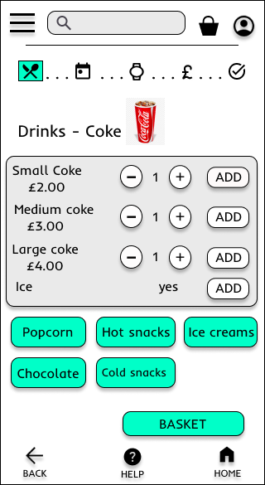
This is an example of the drinks menu options. Clicking on the green buttons, Popcorn, Hot snacks etc, would take you to their respective options page.

Slide 9
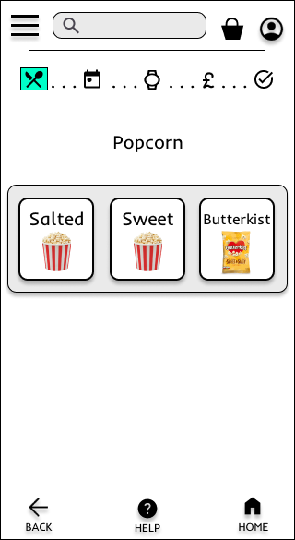
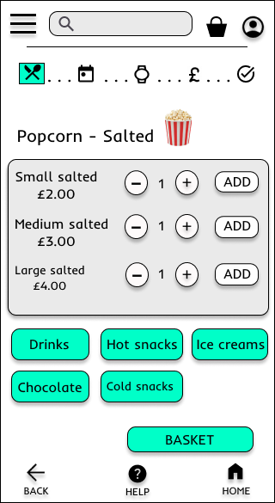
Same format as before with the drinks / Coke page.

Slide 10
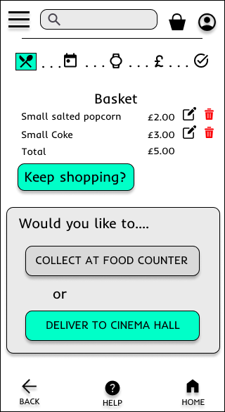
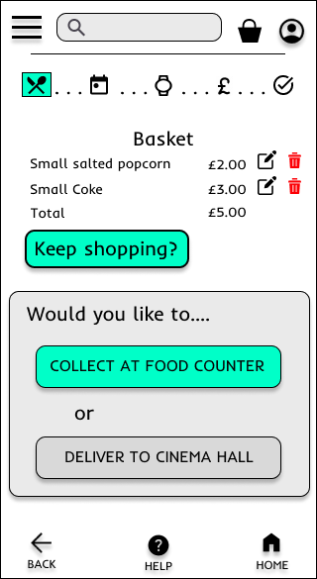
This is my two way designed system - choose counter collection or cinema hall delivery. This is for counter collection.
This is for cinema hall delivery.

Slide 11
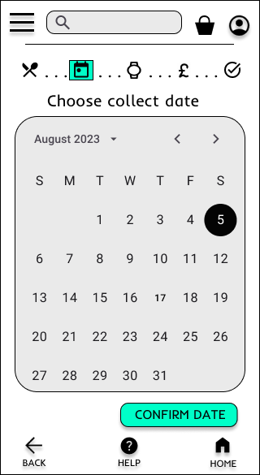
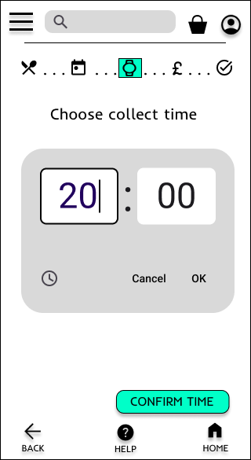
Date chooser for user input.
Time picker for user input.

Slide 12
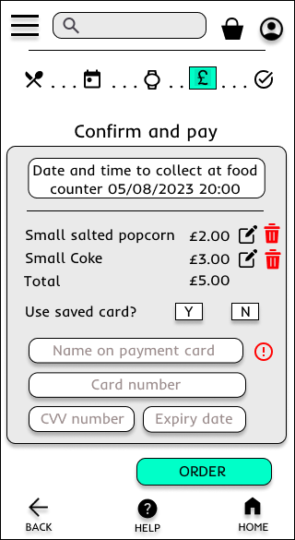
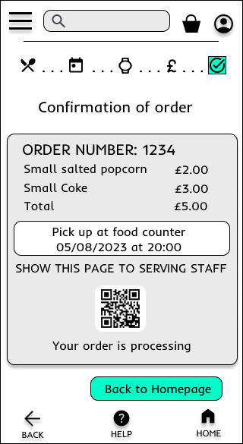
Confirm and pay.
Confirmation of order for which the staff would scan their QR code at counter collection.

Slide 13
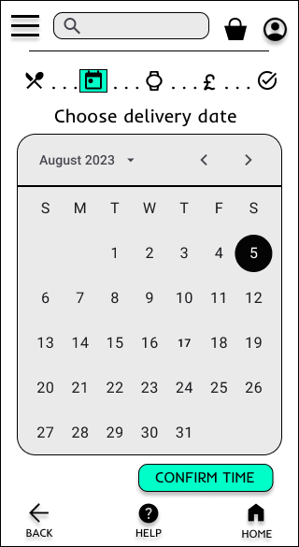
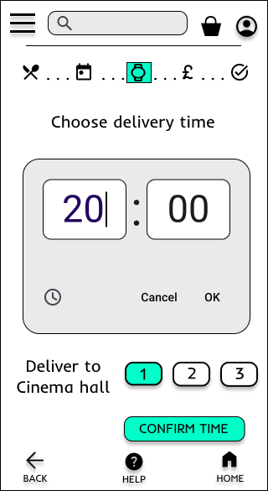
Same as collection date and time but this time, the user clicks which cinema hall for delivery.

Slide 14
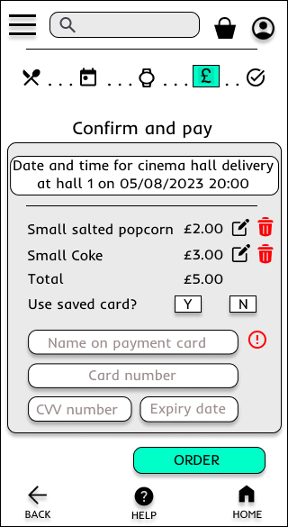
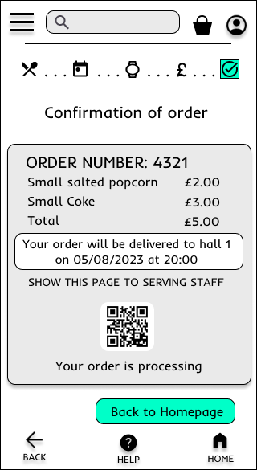
This is the same as collection confirm and pay and confirmation but the details will be delivery based.

